Slide 1
Database Concepts

Slide 2
Topics Covered
Functional Dependency
Armstrong's Axioms
Types of Functional Dependency
Normalization
First Normal Form
Second Normal Form
Third Normal Form
Boyce-Codd Normal Form

Slide 3
Functional Dependency
Functional dependency (FD) is a set of constraints between two attributes in a relation.
when one attribute determines another attribute
Functional dependency is represented by an arrow sign (→) that is, X→Y, where X functionally determines Y.
The left-hand side attributes determine the values of attributes on the right-hand side.
Dependent : right side of the functional dependency.
Determinant : left side of the functional dependency

Slide 4

Functional Dependency
if we know the value of Employee number, we can obtain Employee Name, city, salary, etc.
By this, we can say that the city, Employee Name, and salary are functionally depended on Employee number.

Slide 5
Armstrong's Axioms
Axioms is a set of inference rules used to infer all the functional dependencies on a relational database
Reflexive rule − If alpha is a set of attributes and beta is subset of alpha, then alpha holds beta.
Augmentation rule − If a → b holds and y is attribute set, then ay → by also holds. That is adding attributes in dependencies, does not change the basic dependencies.
Transitivity rule − Same as transitive rule in algebra,
if a → b holds and b → c holds, then a → c also
holds. a → b is called as a functionally that determines b.

Slide 6
Types of Functional Dependency
Multivalued dependency
Multiple independent multivalued attributes in a single table
Trivial functional dependency
FD, X → Y holds, where Y is a subset of X, then it is called a trivial FD. Trivial FDs always hold.
Non-trivial functional dependency
FD X → Y holds, where Y is not a subset of X
Transitive dependency
FD which happens when t is indirectly formed by two functional dependencies.

Slide 7
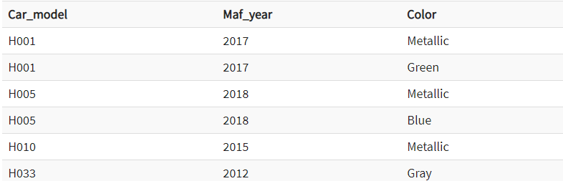
Multivalued dependency
In this example, maf_year and color are independent of each other but dependent on car_model.
These two columns are said to be multivalued dependent on car_model.
This dependence can be represented like this:
car_model -> maf_year
car_model-> colour

Slide 8

Trivial functional dependency
Consider this table with two columns Emp_id and Emp_name.
{Emp_id, Emp_name} -> Emp_id is a trivial functional dependency as Emp_id is a subset of {Emp_id,Emp_name}.

Slide 9

Non-Trivial functional dependency
(Company} -> {CEO} (if we know the Company, we knows the CEO name)
But CEO is not a subset of Company, and hence it's non-trivial functional dependency.

Slide 10
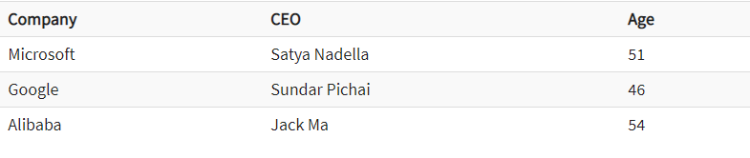
Transitive functional dependency
{Company} -> {CEO} (if we know the compay, we know its CEO's name)
{CEO } -> {Age} If we know the CEO, we know the Age
Therefore according to the rule of rule of transitive dependency:
{ Company} -> {Age} should hold, that makes sense because if we know the company name, we can know his age.
Note: You need to remember that transitive dependency can only occur in a relation of three or more attributes..

Slide 11
Normalization
Normalization is a method of organizing the data in the database which helps you to avoid data redundancy, insertion, update & deletion anomaly.
It is a process of analyzing the relation schemas based on their different functional dependencies and primary key.
Normalization is a method to remove all these anomalies and bring the database to a consistent state.

Slide 12
Normalization
Update anomalies
If data items are scattered and are not linked to each other properly, then it could lead to strange situations. For example, when we try to update one data item having its copies scattered over several places, a few instances get updated properly while a few others are left with old values. Such instances leave the database in an inconsistent state.
Deletion anomalies
We tried to delete a record, but parts of it was left undeleted because of unawareness, the data is also saved somewhere else.
Insert anomalies
We tried to insert data in a record that does not exist at all.

Slide 13

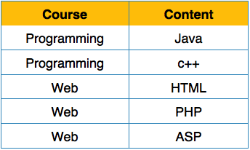
First Normal Form
This rule defines that all the attributes in a relation must have atomic domains.
The values in an atomic domain are indivisible units.
We re-arrange the relation (table) as below, to convert it to 1st Normal Form.
Each attribute must contain only a single value from its pre-defined domain.

Slide 14
Second Normal Form
Before we learn about the second normal form, we need to understand the following −
Prime attribute − An attribute, which is a part of the candidate-key, is known as a prime attribute.
Non-prime attribute − An attribute, which is not a part of the prime-key, is said to be a non-prime attribute.
If we follow second normal form, then every non-prime attribute should be fully functionally dependent on prime key attribute.
That is, if X → A holds, then there should not be any proper subset Y of X, for which Y → A also holds true

Slide 15
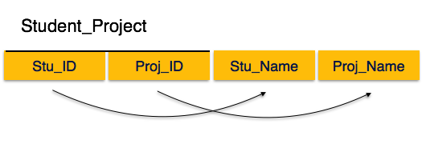
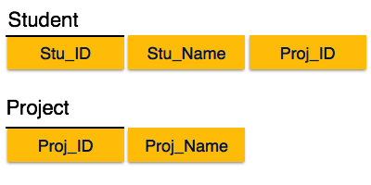
Second Normal Form
Student_Project relation that the prime key attributes are Stu_ID and Proj_ID.
According to the rule, non-key attributes, i.e. Stu_Name and Proj_Name must be dependent upon both and not on any of the prime key attribute individually.
But we find that Stu_Name can be identified by Stu_ID and Proj_Name can be identified by Proj_ID independently. This is called partial dependency, which is not allowed in Second Normal Form.

Slide 16
Third Normal Form
For a relation to be in Third Normal Form, it must be in Second Normal form and the following must satisfy −
No non-prime attribute is transitively dependent on prime key attribute.
For any non-trivial functional dependency, X → A, then either −
X is a superkey or,
A is prime attribute.

Slide 17
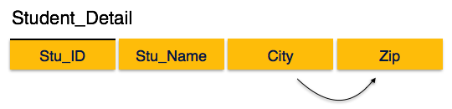
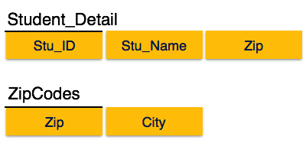
Third Normal Form
We find that in the above Student_detail relation, Stu_ID is the key and only prime key attribute.
We find that City can be identified by Stu_ID as well as Zip itself. Neither Zip is a superkey nor is City a prime attribute. Additionally, Stu_ID → Zip → City, so there exists transitive dependency.
To bring this relation into third normal form, we break the relation into two relations as follows −

Slide 18
Boyce-Codd Normal Form
Boyce-Codd Normal Form (BCNF) is an extension of Third Normal Form on strict terms. BCNF states that −
For any non-trivial functional dependency, X → A, X must be a super-key.
In the above image, Stu_ID is the super-key in the relation Student_Detail and Zip is the super-key in the relation ZipCodes. So,
Stu_ID → Stu_Name, Zip
and
Zip → City
Which confirms that both the relations are in BCNF.

